Slide 1

NFC Pedometer & Location Based Social Game for Tourists
Nakayama Angelica

Slide 2
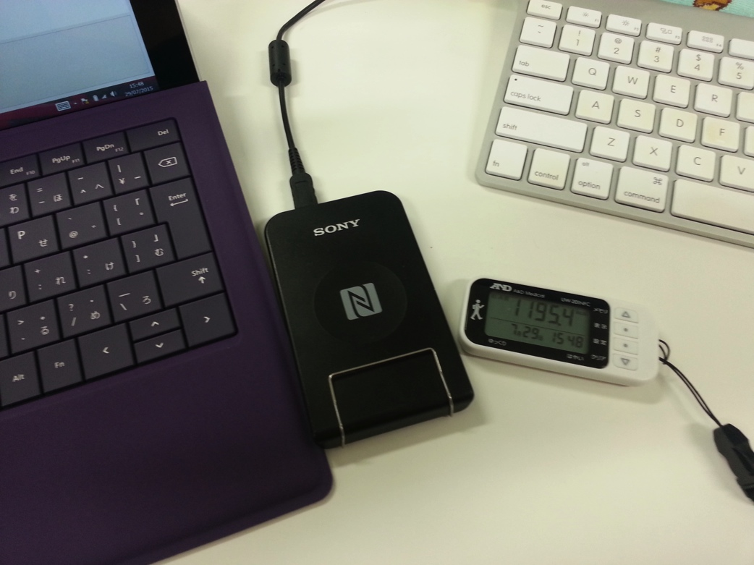
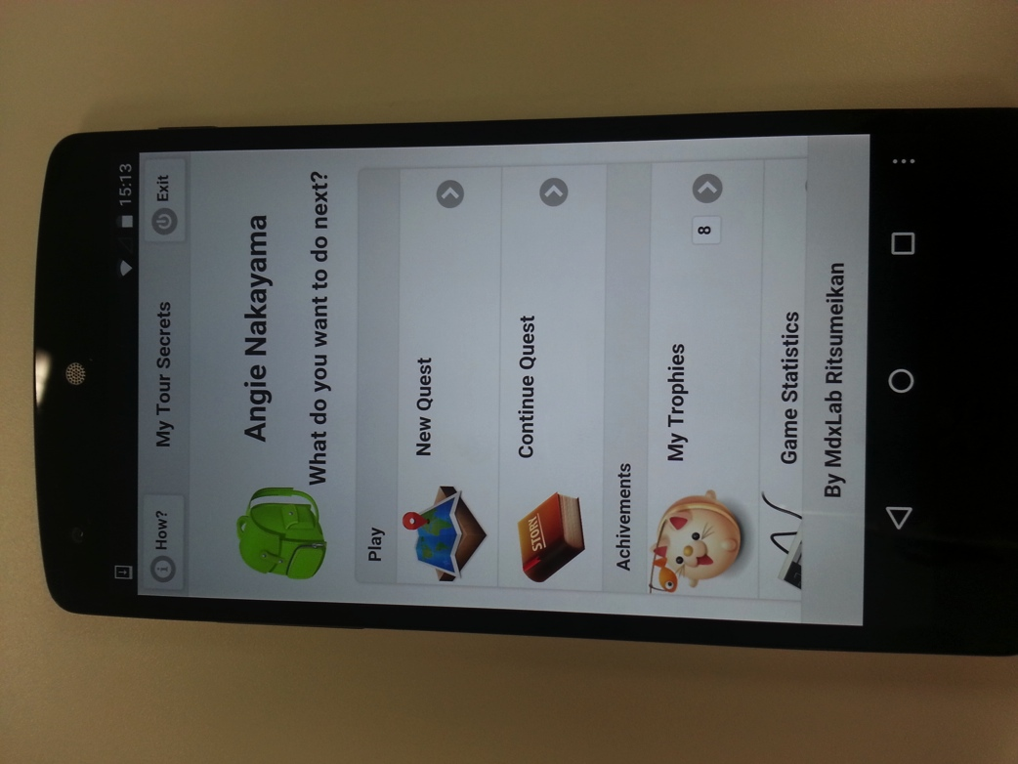
NFC Pedometer
Location Based Social Game for Tourists
for Tekupeko project
(May ~ Aug)
(Aug ~ Oct)
Notes:
During my stay on Ritsumeikan University I worked on two different projects:
First on the NFC Pedometer for Tekupeko project (From May to August)
And the second is a Location Based Game focused on tourism (From August to October)

Slide 3

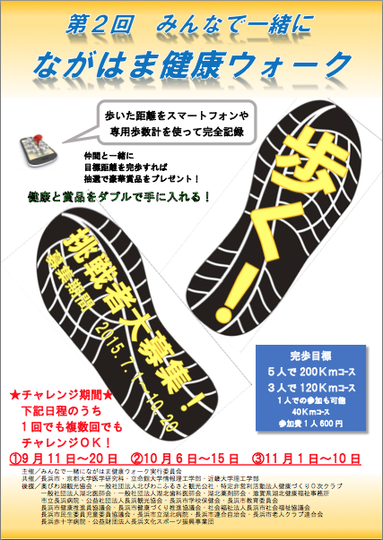
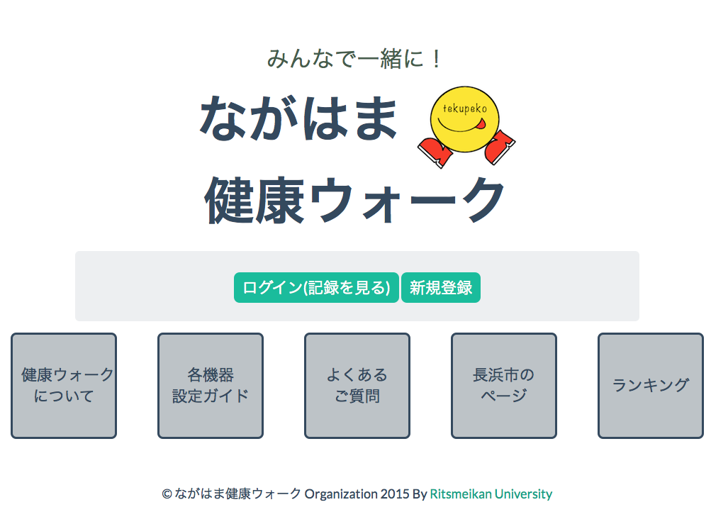
NFC Pedometer for Tekupeko
Notes:
Tekupeko is a project for making people walk more using mobile technologies (smartphones).
This project was developed in Multimedia Experience Laboratory (by Suzuki san and Wakao san) it was used last year (and also this year) on a walking for health event.
Android and iPhone app already developed and in phase of redesign and improvement.
There is also a webpage where you can register and see your progress, make teams, etc.

Slide 4
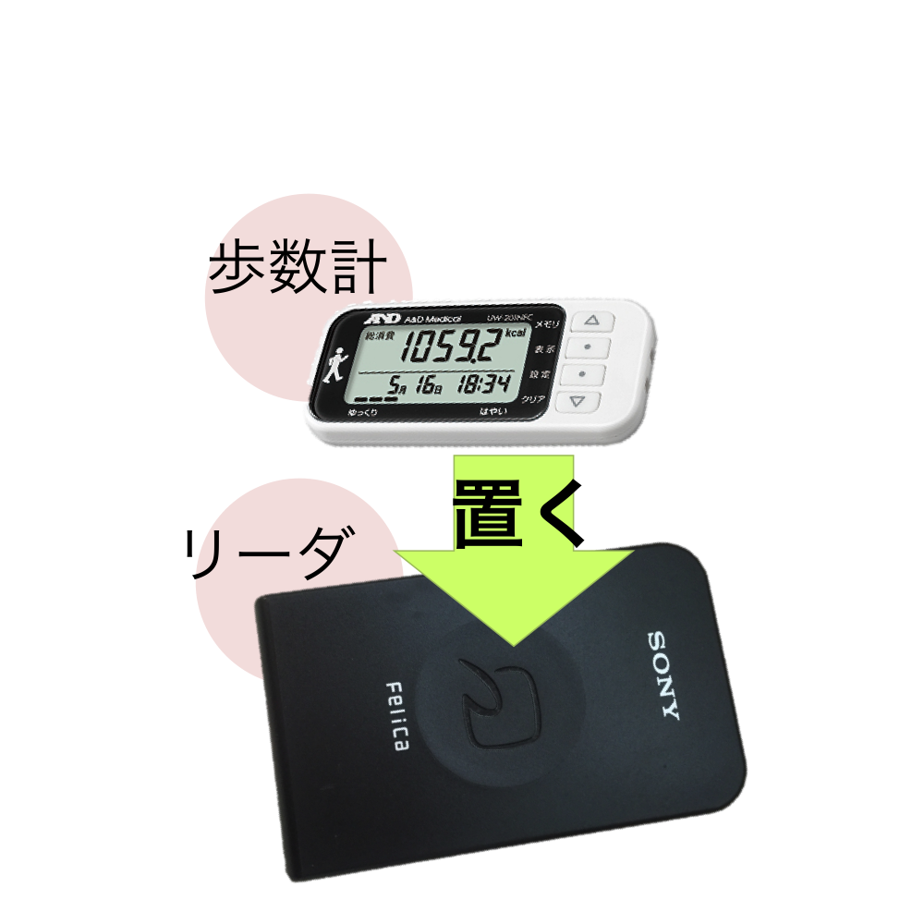
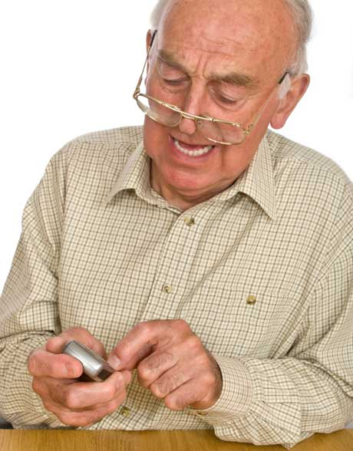
NFC Pedometer
But what about people without smartphones?
Notes:
But what about people without smartphones? The solution: NFC pedometer
By using a NFC pedometer we can make this people to enter the event.
No need to buy a expensive device and learn complicated things to use it.
Just carry the device on their pocket and go to registration point once a while.
Using NFC technology we can transfer walking data from pedometer to the event website.

Slide 5
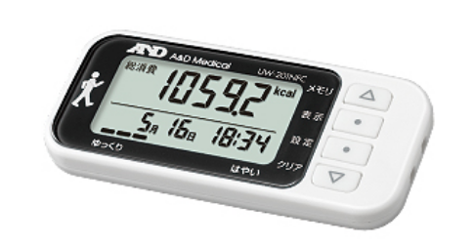
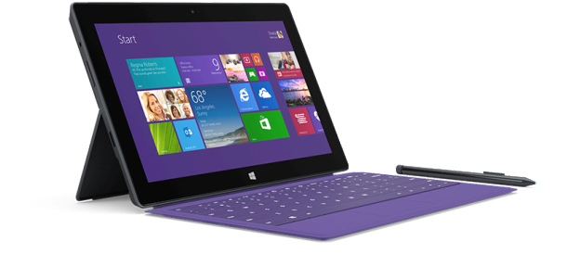
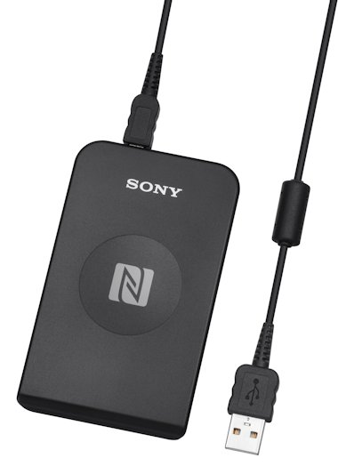
Hardware
NFC Pedometer
A&D Medical UW-201NFC
NFC reader
Sony RC-S380
Windows Surface Pro 3
Notes:
The hardware we have for this project is:
-NFC Pedometer form A&D Medical, model UW-201NFC
-Sony NFC reader model RC-S380
-Windows Surface Pro 3 PC Machine

Slide 6
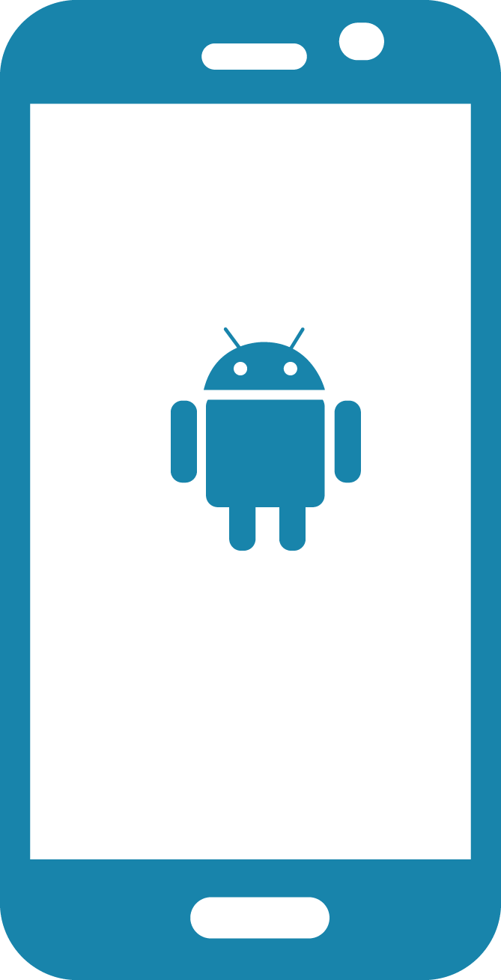

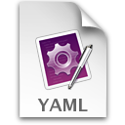

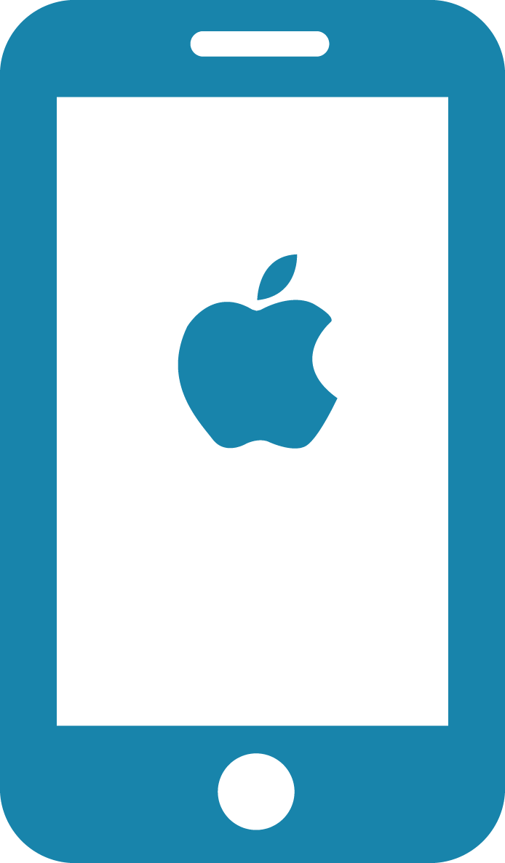
Django
Tekupeko server
Pedometer
Reader
Android
Tekupeko app
Moves Relay App
GIT
Server
Moves
Server
YAML
File
PC app
Notes:
This is the diagram of the system’s design.
Media Lab team already has the mobile part in development by using the “moves app” and a proprietary one. They were on the redesign and improvement of these apps.
But they needed someone to take care of the pedometer part, so they asked me to do this, and to integrate it with what they already had.
The idea was to read the data from the pedometer via NFC with the reader into the windows PC, and generate a Yaml file to upload it to a git server.
After this, they would develop some code to get the file from the git server and add it to their data base on the tekupeko server, so it would be no difference with the data from the mobile apps.

Slide 7
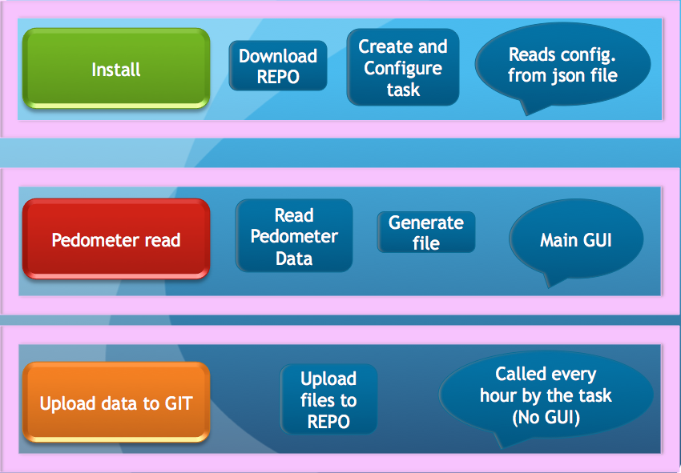
General design
Notes:
To achieve this, I divided the problem into 3 parts:
Install, Read and Upload.

Slide 8
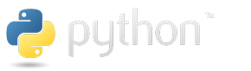



Programing
Python 2.7 & C (Programing languages)
NFCPY Library for Python and NFC (open source)
Git (Version Control System) Github server (testing)
Sony NFC Port Software (Driver for RC-S380 freeware)
Sony SDK for NFC Starter Kit (freeware)
Sony NFC Healthcare Library (request and registration to use )
Notes:
These are the programing tools and languages needed.

Slide 9
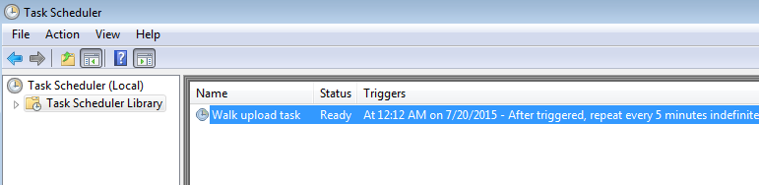
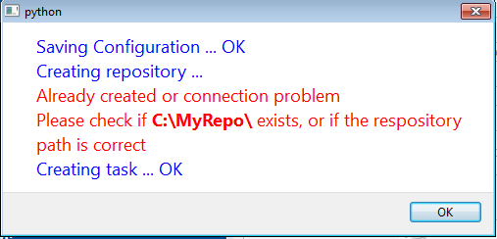
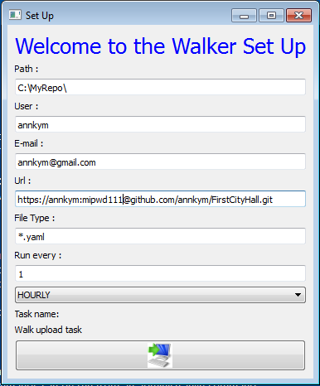
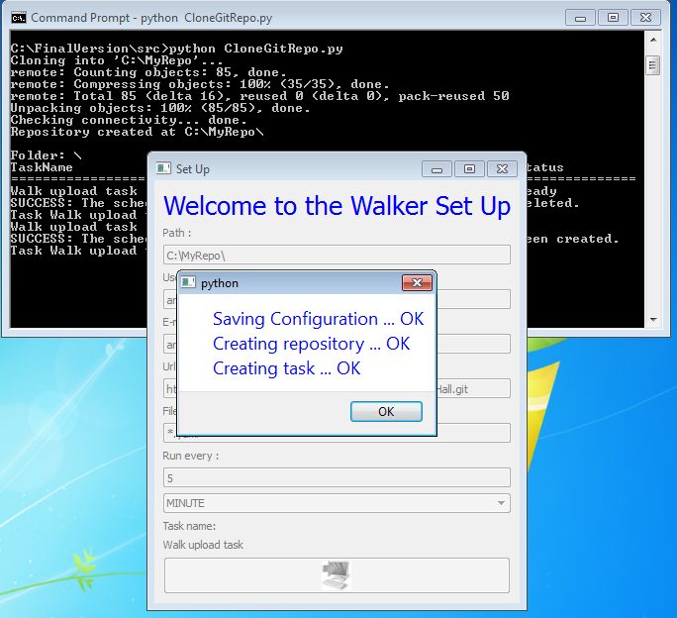
Notes:
First part is to download the repository from git server and to create a programed task to upload the files. All this should be configurable by a json file.
All developed with python and has a window where you can configure all.

Slide 10
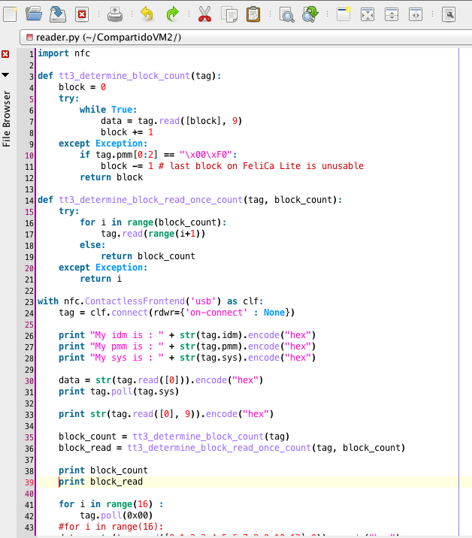
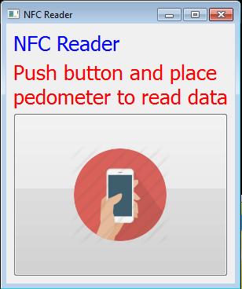
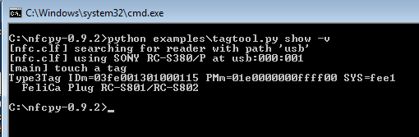
Notes:
Second part is the pedometer read data, and generate the yaml file. This has the main graphic user interface that regular users will see.
First approach, was using NFCpy library for python but it was difficult to read data, because it needs to read data blocks, and translate it to pedometer data… too complicated!

Slide 11
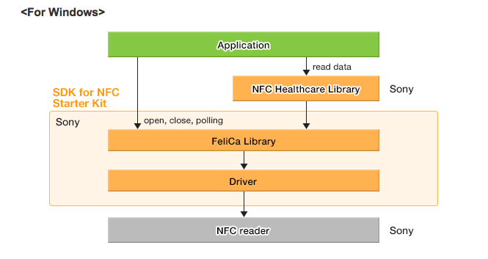
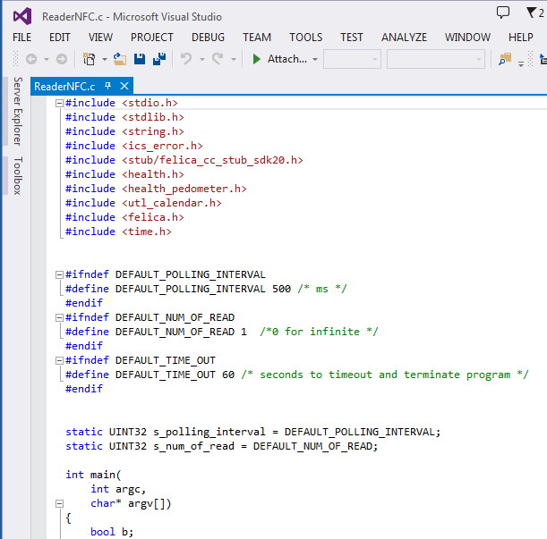
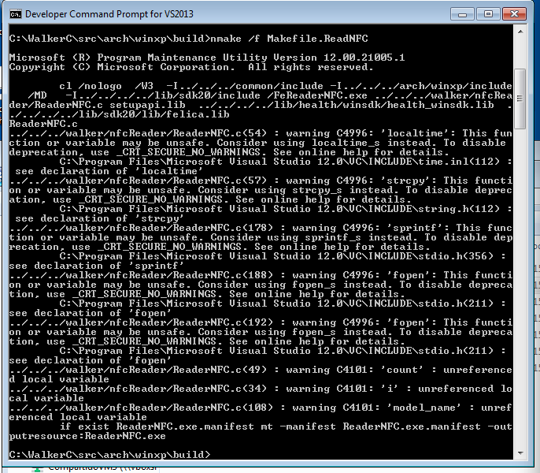
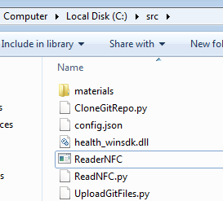
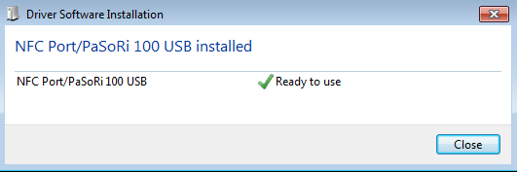
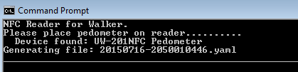
Notes:
So changed to use the Sony libraries for NFC and a special one made for health devices like NFC Pedometer.
(Sony NFC Port Driver, Sony SDK for NFC, Sony NFC Healthcare Library)
These libraries are programmed with C and Visual Studio and generate an .exe (window executable) program.

Slide 12
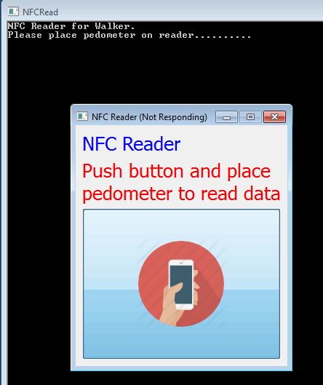
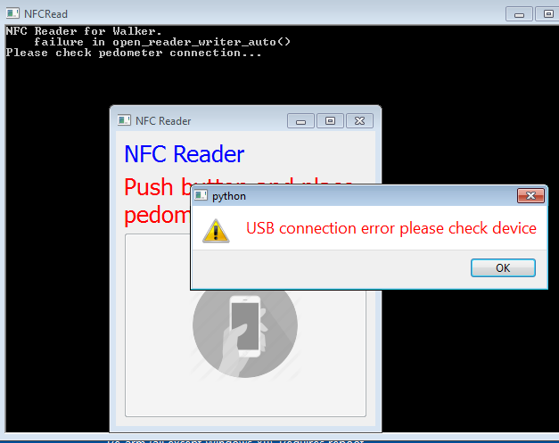
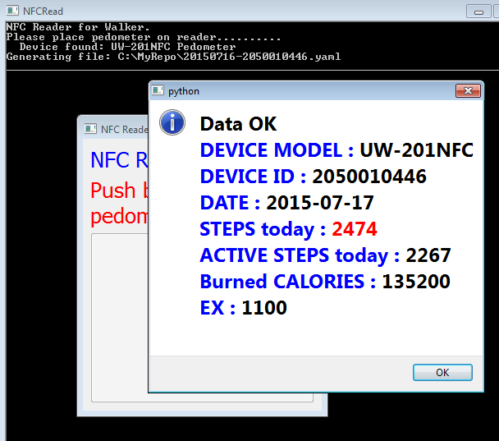
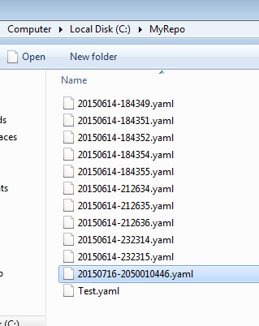
Notes:
To make all work together, I had to change some python code to make the call to the .exe program and display the results on python window.

Slide 13
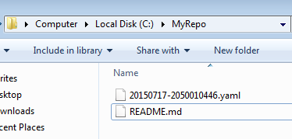
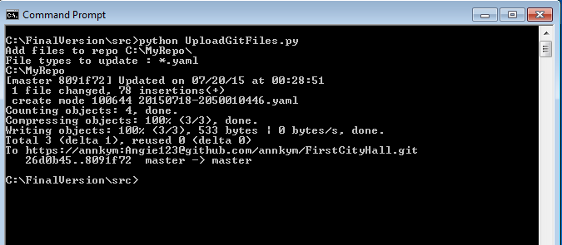
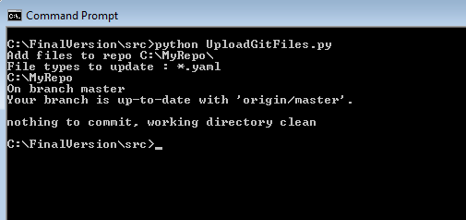
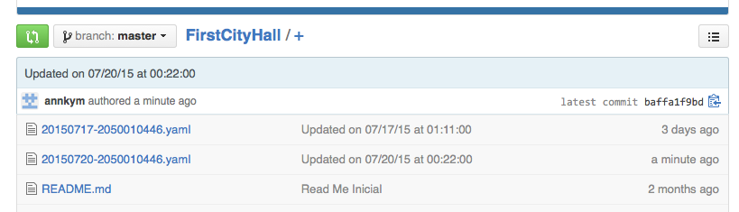
Notes:
Third part is the upload to git server, this has to run automatically every hour or as programed on the first part. This part has no interaction with the user.
Programed on python to call git commands, and being executed by the windows task scheduler.

Slide 14
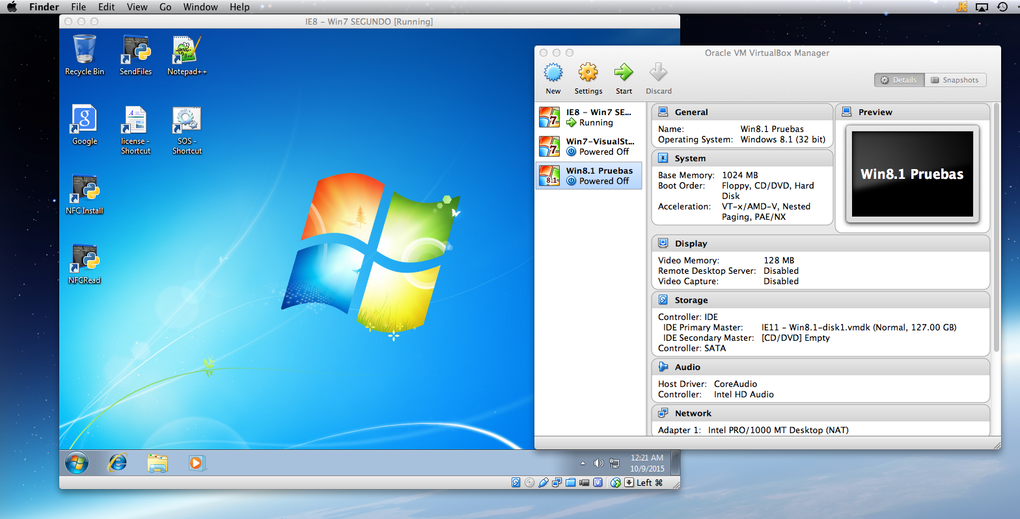
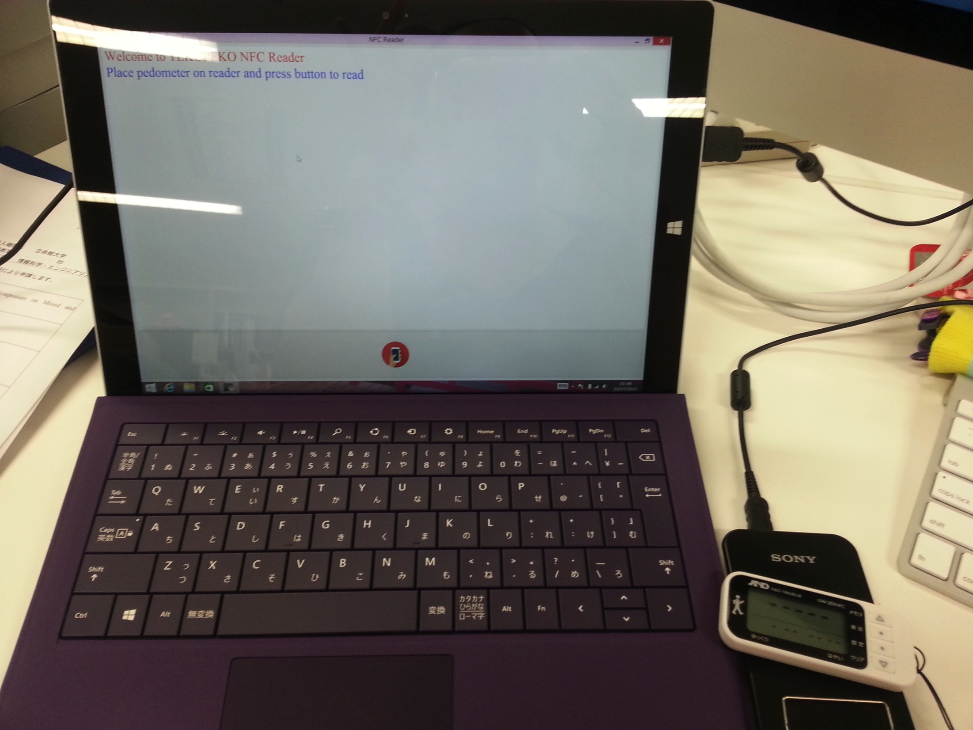
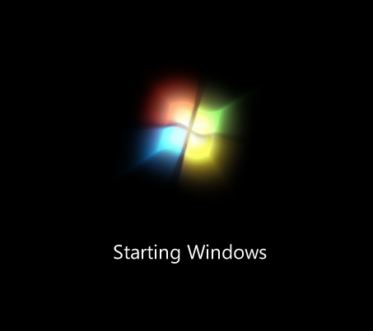
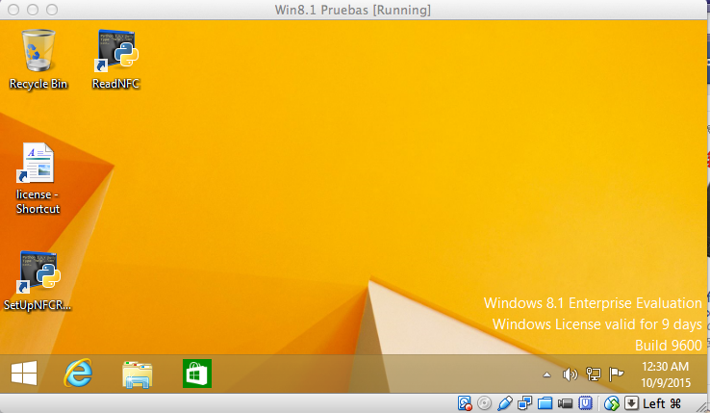
Testing
Virtual box
Virtual machine Windows 7 & 8
Final testing on Windows surface PRO 3 with Windows 8
Notes:
The testing environments were Virtual machines on virtual box with windows 7 and 8.
For the final testing and pre-installation for walking event, a Windows surface pro 3 on windows 8.

Slide 15
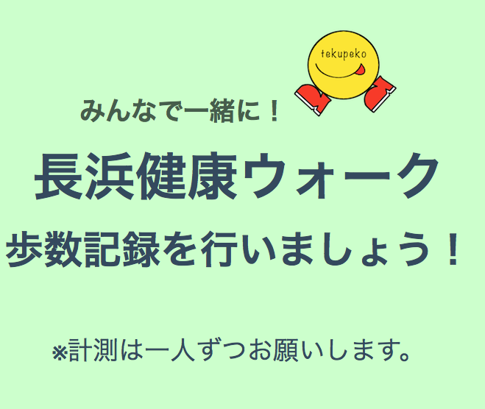
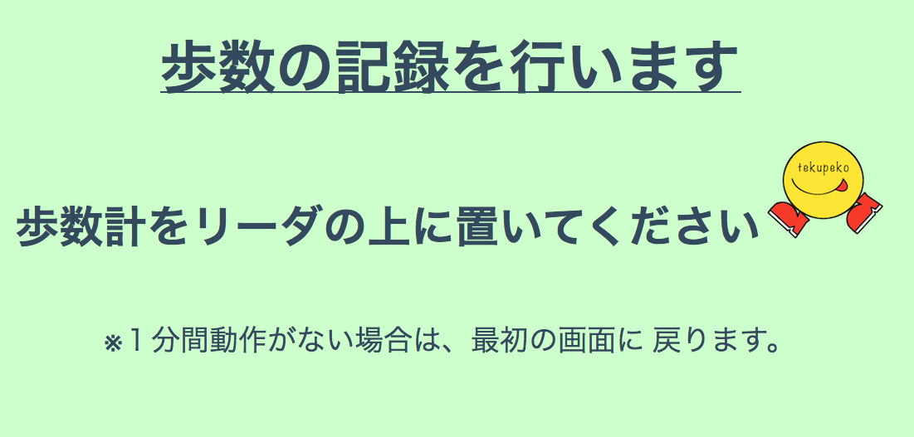
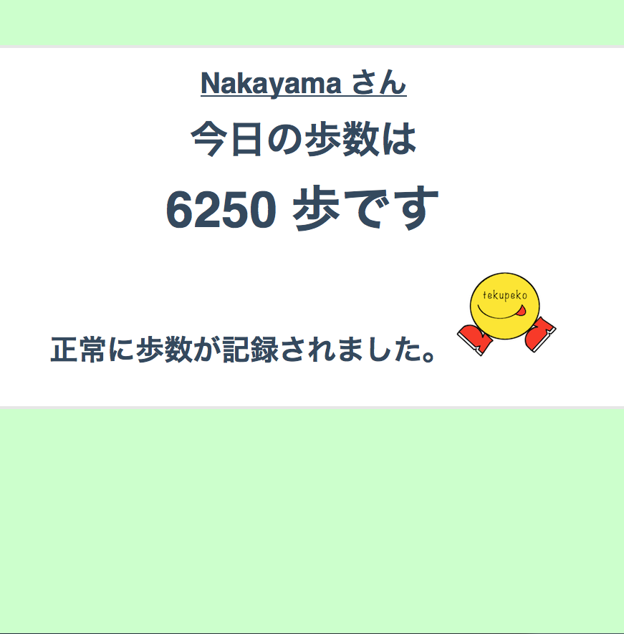
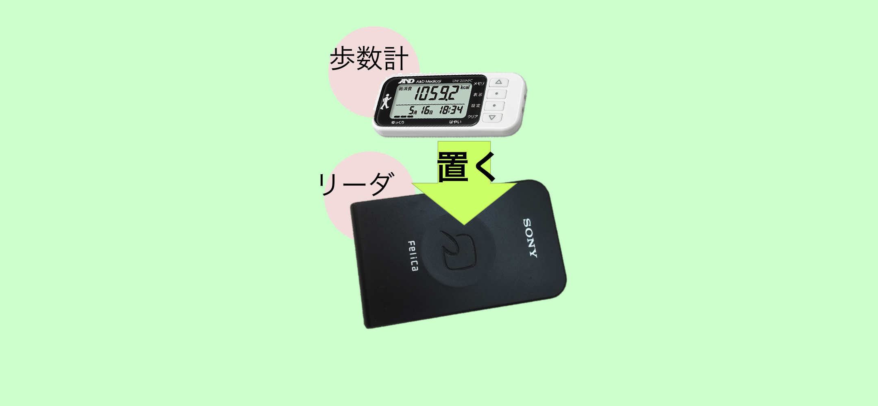
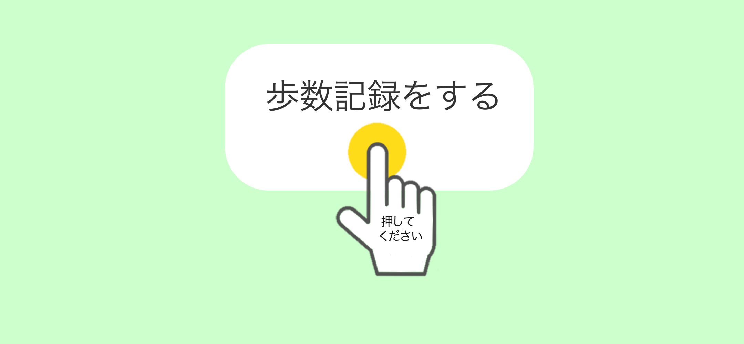
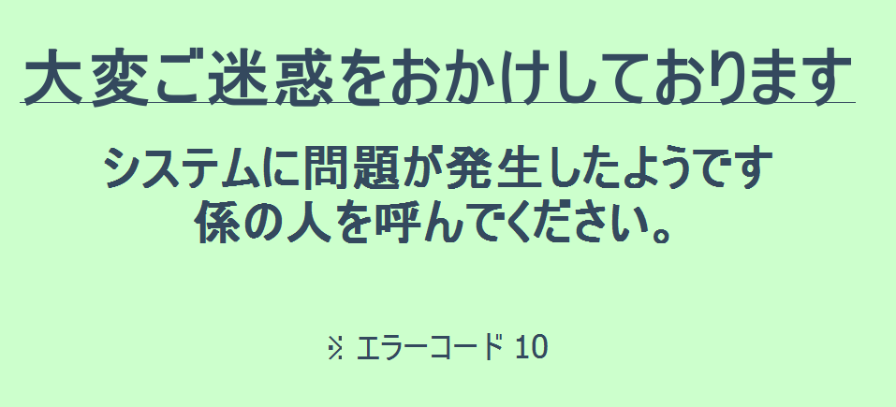
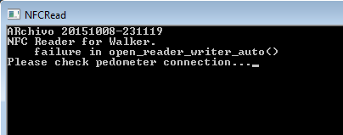
Final GUI design for walking event
Notes:
Finally, Wakao san, helped me to change the GUI to be in Japanese and web based design.
Just integrate her web design to be called from the python code.

Slide 16
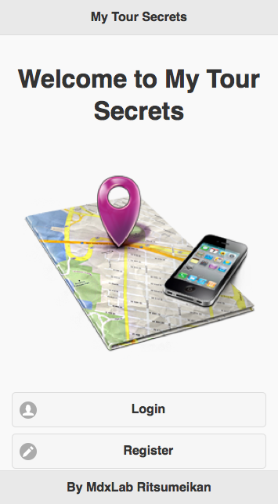
Location Based Social Game for Tourists
A location-based game (LBG) is a type of game where the experience is extended out in the real world and the gameplay evolves and progresses via a player's location (by GPS).
LBG may induce learning.
Notes:
The second project is a mobile game (LBG for tourism)

Slide 17
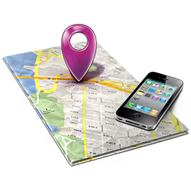


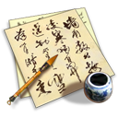
Why?
The purpose of this game is to make people know more about sights and learn interesting facts about them.
To have fun while traveling, enjoy the secrets that tourist places have and to share it with friends.

Slide 18
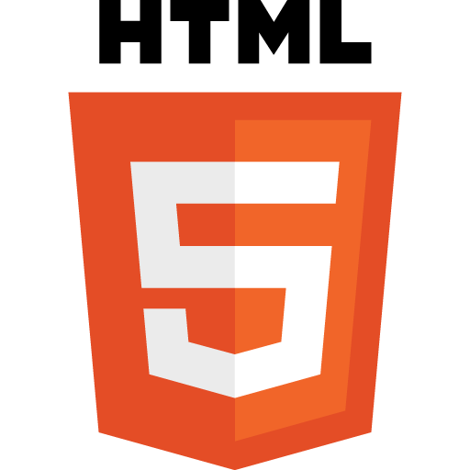






Design &Technology
HTML 5 and JS
JQuery & JQuery Mobile
Google Maps api for JS
PhoneGap
PhoneGap Build
Notes:
This is the technologies used to develop the game.
HTML 5 and Java Script for the main interface and programming.
PhoneGap to generate te hybrid app
PhoneGap Build to compile and generate the apk (for android) also can generate version for iOS, windows, etc,

Slide 19







Notes:
This is the flow of the app:
Logging or register, main menu, and how to play screens.

Slide 20









Notes:
To play a new game, you can chose country, and city or touristic place.
When you start you get a Clue to try to find out where to go (like a treasure hunt)
You can buy more clues (using stars), photo clues or location (GPS) clues.

Slide 21










Notes:
With location Clues:
If you are too far from the place, you only get a message with the distance to the place on meters.
If you are less than 1 Km to the place you get a Red circle around you, to show you the area where the place can be…
If you are at 100 m. or less you are considered to have found the place.
In this case you can activate the checkpoint button and win some stars and a trophy!!

Slide 22






Notes:
You can continue the games you have on your account, and also have a gallery of your trophies.
This app was tested on web browser and Android devices, but using PhoneGap and PhoneGap build we can generate the corresponding versions without changing any code.

Slide 23



Future work
Add social sharing (Invite friends, share on Facebook, Twitter, etc.)
Customizable routes
Play on teams
Notes:
Future work:
Finish the demo.
Add social sharing or add friends who also have the app.
Be able to customize your routes, may be to play on your city with your own clues
Make teams to play against other teams.

Slide 24
Thank you!!!
Q & A

Slide 25

NFC
Additional notes
NFC (Near field Communication) is the set of protocols that enable electronic devices to establish radio communication with each other by touching the devices together, or bringing them into proximity to a distance of typically 10cm or less
Each full NFC device can work in three modes:
NFC Card emulation mode enables NFC-enabled devices such as smartphones to act like smart cards, allowing users to perform transactions such as payment or ticketing.
NFC Reader/writer mode enables NFC-enabled devices to read information stored on inexpensive NFC tags embedded in labels or smart posters.
NFC peer-to-peer (P2P) mode enables two NFC-enabled devices to communicate with each other to exchange information in an adhoc fashion

Slide 26

NFC Tags
NFC tags typically contain data and are read-only, but may be rewritable. NFC tags can be custom-encoded by their manufacturers or use the industry specifications provided by the NFC Forum.
NFC Forum defines 4 distinct types of tags that provide different communication speeds and capabilities in terms of flexibility, memory, security, data retention and write endurance.
Type 3 Tag is based on the Japanese Industrial Standard (JIS) X 6319-4. This tag type is pre-configured at manufacture to be either read and re-writable, or read-only. Example: Sony FeliCa

Slide 27







Sony FeliCa & PaSoRi
FeliCa is a contactless RFID smart card system from Sony in Japan, used in e-money, public transportation, and student id cards (ICCOCA, Suica, Manaca, PiTaPa, etc.) as well as in consumer electronics.
The name stands for Felicity Card
Sony has an external USB FeliCa PC reader/writer called PaSoRi. (Sony RC-S380)

Slide 28


A&D NFC Pedometer
UW-201NFC
Notes:
NFC Dynamic Tag is a wireless-interface product, which can be embedded into electronic devices, enabling the device to communicate with any NFC reader/writer or with any NFC smartphone
http://www.sony.net/Products/felica/casestudy/healthcare.html

Slide 29





Notes:
Python 2.7 Anaconda Distribution
Python libraries QtPy, pyside,nfcpy, libusb, apscheduler
Git command prompt
NFC usb driver with libusb-win32

